Slide 1
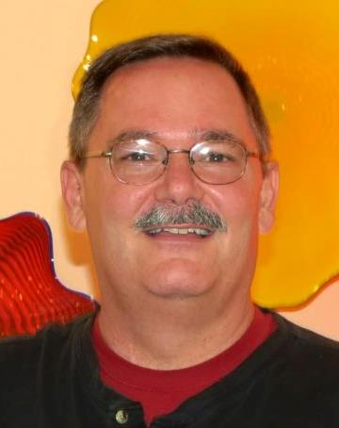
A Visit From Brad Munroe (Presbytery Pastor/Exec) and some Pros and Cons

Slide 2
Speaking the truth in love
Please Remember to
Be Prayerful. . .
Be Thoughtful. . .
Be Respectful. . .
Speak Responsibly. . .
We can do this!

Slide 3
Last week we discussed
Scriptural values
Theological focus
Institutional health
Economic sustainability
Political orientation

Slide 4
Reasons For Staying with PC USA
We don’t have to do anything
We have made it this long
without any issues
We are not forced to believe /
do what PC USA does

Slide 5
Reasons For Staying with PC USA
We are familiar with the systems
No additional expense for staying
Tradition – it’s where we have been
Pastor continues benefits and pension

Slide 6
Reasons For Staying with PC USA
The PW will remain intact
We can always revisit the
issues later if we decide to

Slide 7
Reasons For Leaving PC USA
Integrity of our beliefs
We own and keep our property
The potential for a renewed energy

Slide 8
Reasons For Leaving PC USA
Being with a like minded denomination will build stronger relationships with our greater church community
Annual cost will likely be less

Slide 9
Reasons For Leaving PC USA
At least two alternative denominations are more focused on stimulating local churches to faith and mission

Slide 10
What are your reasons?

Slide 11
