Slide 1
Getting Up to Speed our conversation so far. . .

Slide 2
What we believe
Jesus Christ is the same yesterday and today and forever.
Hebrews 13:8

Slide 3
Calls us to act
We must no longer be children, tossed to and fro and blown about by every wind of doctrine, by people’s trickery, by their craftiness in deceitful scheming. But speaking the truth in love, we must grow up in every way into him who is the head, into Christ.
Ephesians 4:14-15

Slide 4
And to interact
I therefore. . . beg you to lead a life worthy of the calling to which you have been called, with all humility and gentleness, with patience, bearing with one another in love, making every effort to maintain the unity of the Spirit in the bond of peace. Ephesians 4:1-3

Slide 5
Speaking the truth in love
Please Remember to
Be Prayerful. . .
Be Thoughtful. . .
Be Respectful. . .
Speak Responsibly. . .
We can do this!

Slide 6
Our “Goals” for this Process
To seek our future together as a faithful witness to Jesus Christ.
To remain fully intact as a family of faith – leaving no one behind along the way.

Slide 7
Do we have a problem?
A discussion begun in response to
General Assembly actions this summer has gradually taken on a much larger and more critical dimension regarding the direction of the PC(USA) with regard to:

Slide 8
Scriptural values
Theological focus
Institutional health
Economic sustainability
Political orientation

Slide 9
We started with two key concerns from General Assembly 2014
Abridgement of Polity
(Using a shortcut to force new policy)
Disregard for Scriptural authority
(Ignoring Biblical direction)

Slide 10
Abridgment of Polity
Misuse of Authoritative Interpretation
Generated
Major shift in policy regarding marriage implemented without Presbytery voice or vote

Slide 11
Authoritative Interpretations
Authoritative interpretation is an interpretation of The Constitution of the Presbyterian Church (U.S.A.) that carries the authority of the General Assembly and is binding on the councils of the church.

Slide 12
Disregard for Scriptural authority
Motion to change Book of Order definition of marriage
Culturally bound without biblical support
Presbytery voting now in process

Slide 13
As we began to read, research & share following these General Assembly actions, our Pastors, Session & some in our congregation began to recognize
still more substantial issues of concern within the denomination.

Slide 14
So, what are the questions we in this church need answered?
Does PC (USA)
believe what we believe
as a congregation?

Slide 15
For example:
The Authority of Scripture
The Saving Lordship of Jesus Christ
The Literal death & atoning sacrifice of Christ

Slide 16
Lets look at what
we have found
Authority of Scripture
62% of pastors in PC (USA) say it is
“Word of God to be interpreted in light of historical context.”
Saving Lordship of Jesus Christ
Only 41% of pastors in PC (USA) agree that “only followers of Jesus can be saved.”
and. . .

Slide 17
Here are some examples:
Death & atoning sacrifice of Christ
In recent years a number of pastors in
PC (USA) have publicly renounced belief that Jesus rose from the dead.
Rev. James Rigby has been quoted as saying, “Maybe a body rose up; I don’t care. That’s not the point.”

Slide 18
Failure to uphold our historic Confessions in matters of practical policy
In 2000 Rev. Dirk Ficca declared as featured speaker in PC(USA) sponsored conference:
“If God is at work in our lives, whether we’re Christian or not, what’s the big deal about Jesus?”
The PC(USA) agency responsible for conference declined to discipline Ficca.

Slide 19
Embracing a culture
of plurality
Asked repeatedly for a concise statement of Presbyterian values, the General Assembly has replied we are simply too diverse to agree on such a proclamation.
PC(USA) “response” finally published on website in Jan. 2015 – merely cites the very Confessions to which we fail to give force.

Slide 20
In 2001 the General Assembly considered motion to declare “the singular, saving lordship of Jesus Christ.” The Motion was defeated & characterized as
“disrespectful to other religions.”

Slide 21
Increasing “politicization” of PC(USA)
The denomination has increasingly taken public political stances deemed unwise & unreflective of mainstream members.
Divestment
Ferguson response

Slide 22
Has our Governing Body become too large to serve the individual churches?
The PC (USA) has become an overly-bureaucratic structure, no longer effective, responsive or life-giving to churches.
Where the denomination once served needs of individual churches, now the process has reversed.
The Denomination has become badly divided along theological & social lines.

Slide 23
If PC (USA) is having financial issues, how will that affect FHPC ?
PC (USA) owns our property
489 churches have left to other denominations in last 4 years. This rate is accelerating.
PC (USA) has gone from 4.25M members in 1965 to 1.76M in 2014. Membership has reduced by 10% in last 2 years, ½ of remaining churches have less than 100 members

Slide 25
28 of 172 presbyteries now have no paid full-time staff leadership, with many presbytery executives working only part time.

Slide 26
Here at home, our Presbytery (Grand Canyon), officed in Phoenix, shares both a “Presbytery Pastor” (formerly known as the “Presbytery Executive”) and a Stated Clerk with DeChristo Presbytery, officed in Tucson. Not even close to a good situation in this time when leadership is so critical.

Slide 27
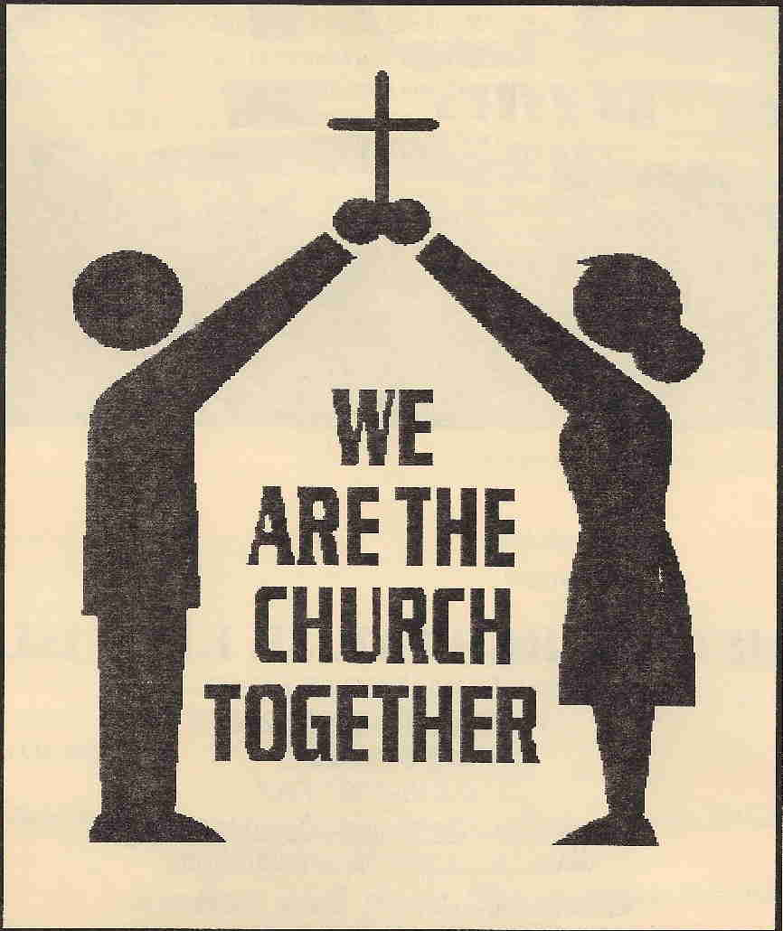
Do we have
a problem?
Let’s talk about it
TOGETHER
as a FAMILY

